Slide 1

Team Delta Sonics
Chirag Satapathy
Anusuiya Bora
Mylena Almeida
Hrishikesh Gokhale

Slide 2

Problem Statement
Learning the concepts of organic chemistry can be a daunting process for high school students. Having clear concepts of basic structures like that of hydrocarbons is essential to have a solid foundation to pursue a career in the same field.
It can also be a tedious task for students, researchers and industrial workers to continuously refer to resources to learn and write down structures of hydrocarbons as per the IUPAC Nomenclature.

Slide 3

How CAN Educhemical HELP?
We aim to provide a simple and easy to use platform for users to obtain structures of straight chain hydrocarbons in just 1 click!
Users can benefit by understandinding basic concepts like systematic nomenclature of organic compounds and visualizing molecular compounds for a better learning experience.
It is also an offline application, i.e. can work without an internet connection.

Slide 4

WORKING
First, all the relevant data such as prefix name, suffix name, functional groups will be stored in the form of structures and arrays. Then, as we get an input in the form of a string, the position and the names will be compared with the stored data to get information such as number of carbons, functional groups, number of bonds to form the complete structure.
The module starts with detecting characters before halogen groups in the IUPAC name (variable name – iupac). It compares the characters with all elements stored in an array named “prefix”(containing all the possible prefixes) one by one. Consequently it stores all the characters before halogens in pretemp array and marks the address of the end of the prefixes group in cbhalo variable.

Slide 5
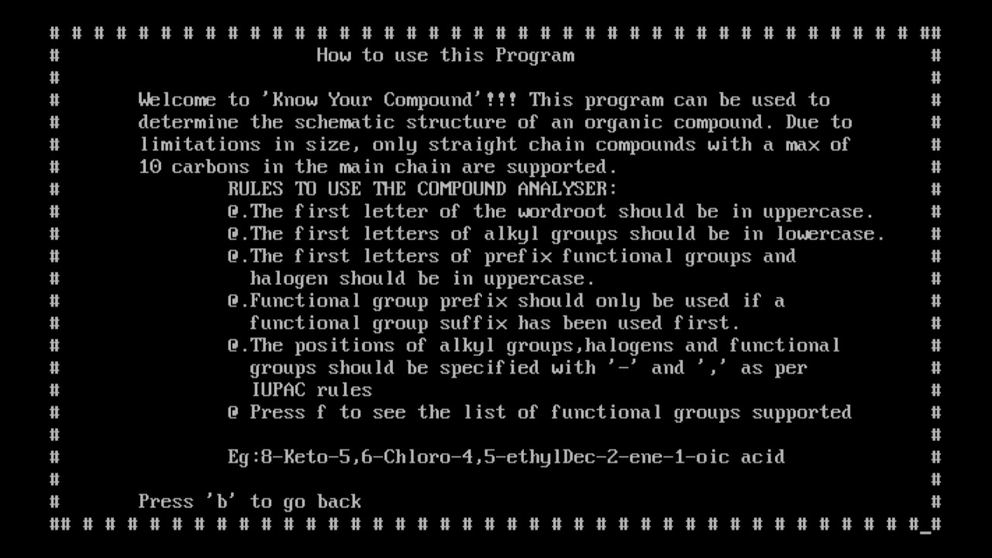
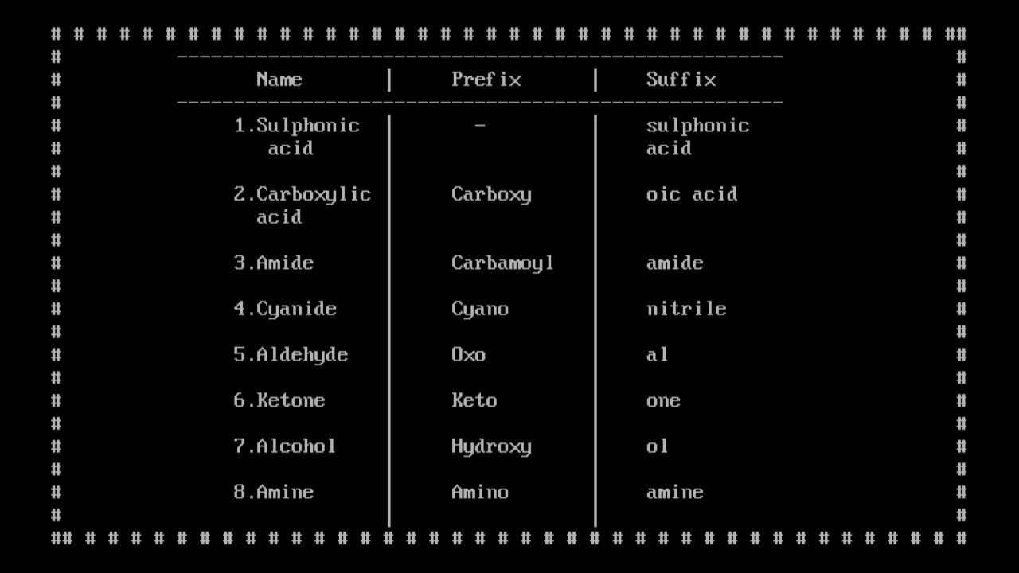
Help option

Slide 6
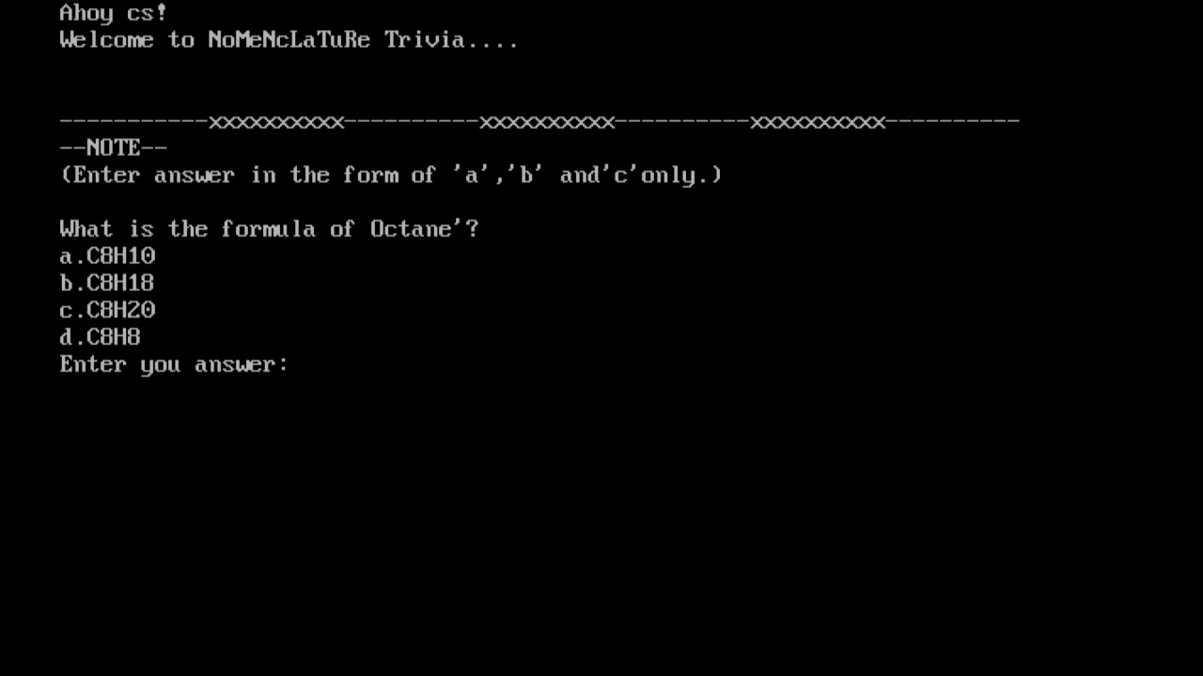
Trivia/Quiz

Slide 7
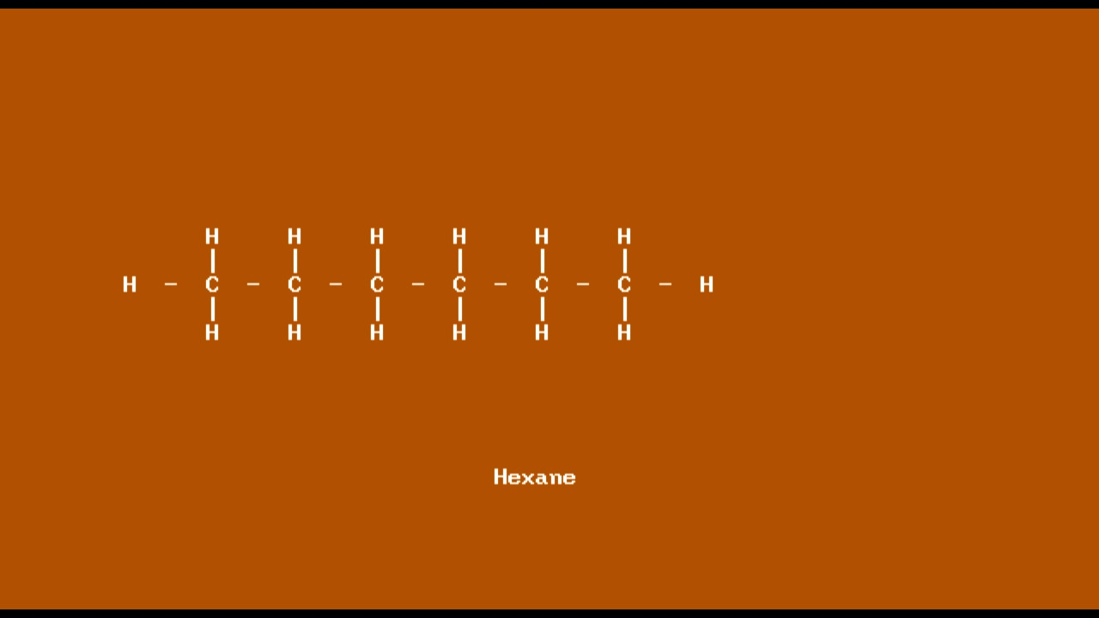
Example 1 - Straight Chain Compounds (HEXANE)

Slide 8
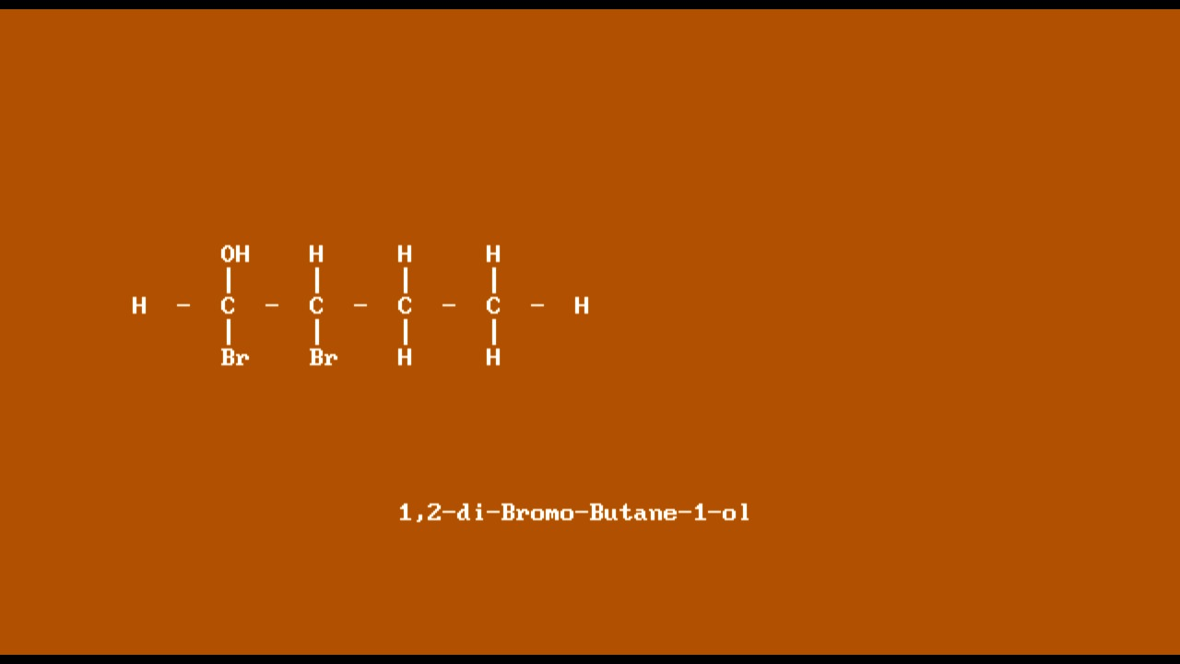
Example 2 - 1,2-di-bromo-butane-1-ol

Slide 9
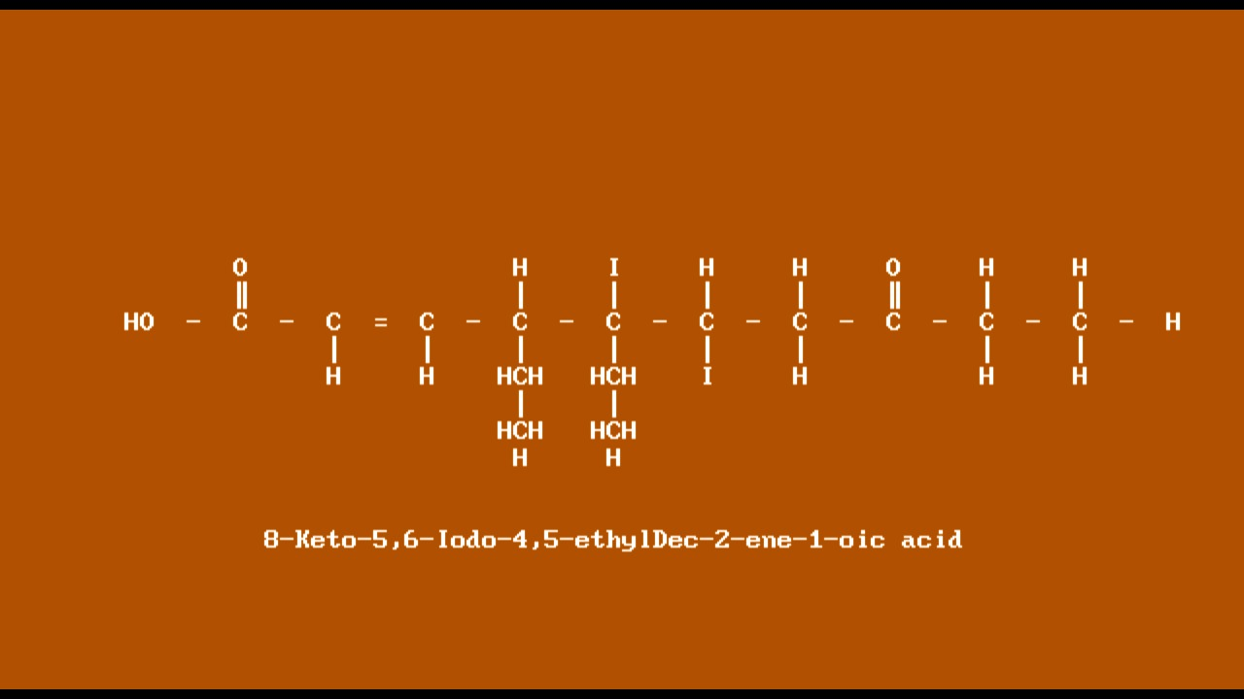
Example 3 - 8-Keto-5,6-iodo-4,5-ethylDec-2-ene-1-oic acid (Multifunctional groups)

Slide 10
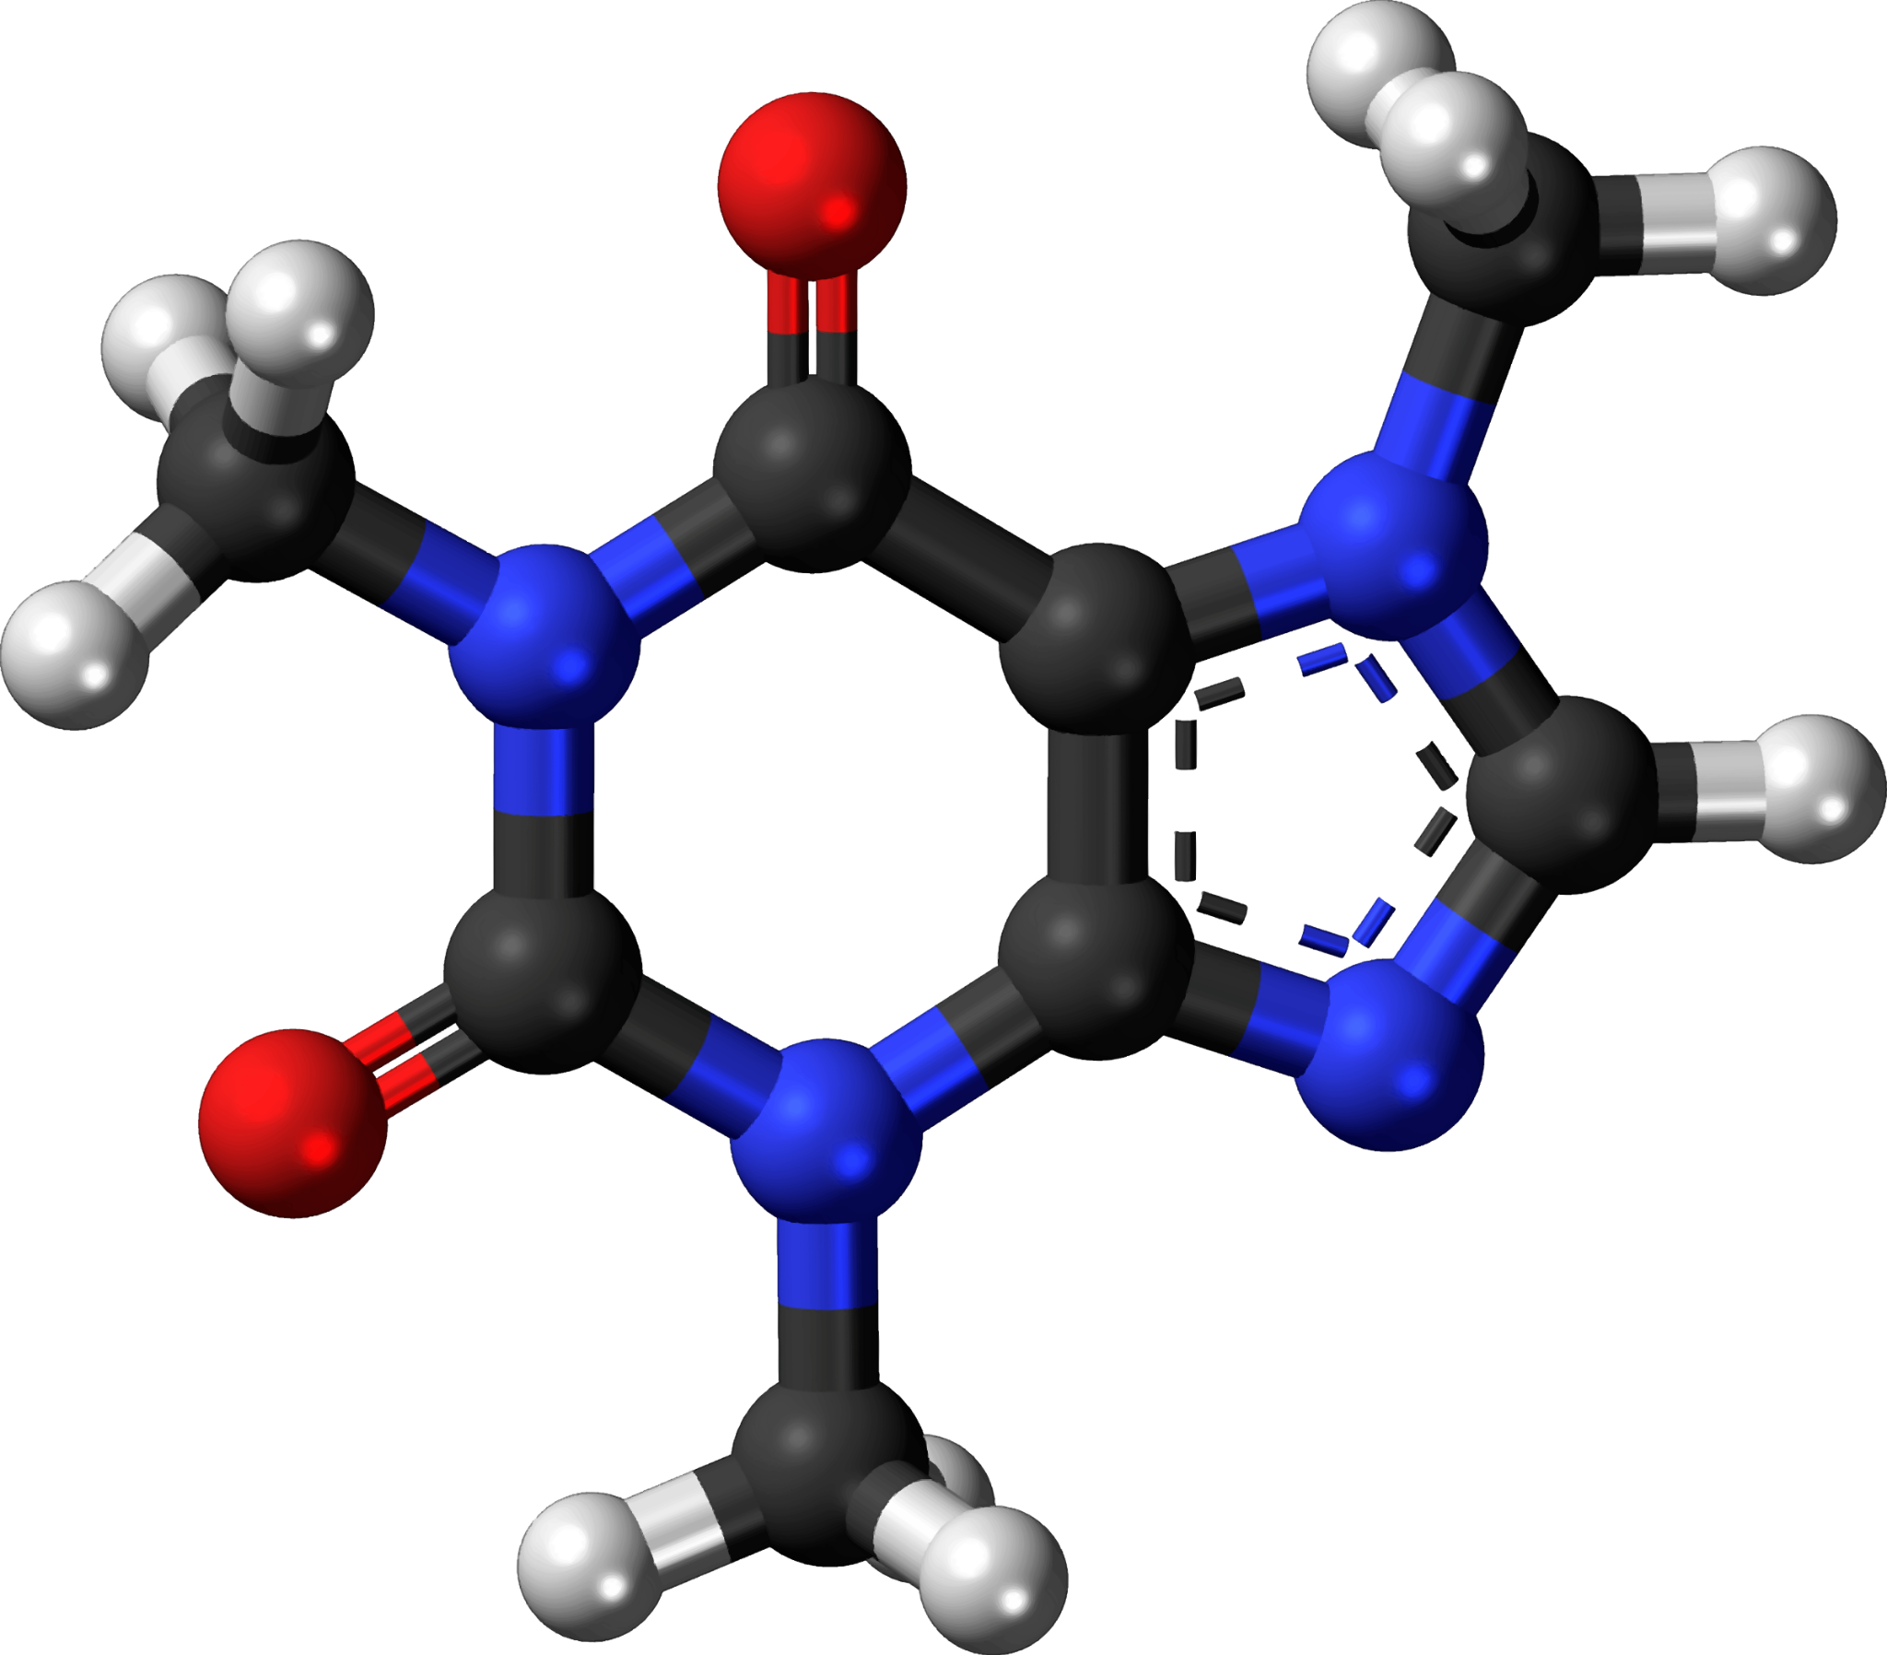
Future Prospects
Expanding the algorithm to compute for higher order organic compounds like aromatic hydrocarbons.
Improvising and integrating the code with the FIGMA prototype of UI/UX.
Providing an educational service to enjoy the process of understanding organic chemistry in depth.

Slide 11

Thank you!

